Slide 1
E-Map: A Visual Analytics Approach for Exploring Significant Event Evolutions in Social Media
Siming Chen, Shuai Chen, Lijing Lin, Xiaoru Yuan, Jie Liang, Xiaolong Zhang
Presented by : Rahmandani(Dani), FNU

Slide 2
Introduction
Entity in Social Media:
Users
Messages
User behaviors :
Posting messages (Tweet)
Commenting and Re-posting (Re-tweet)
Notes:
2 entities that change the event in social media : users and message

Slide 3
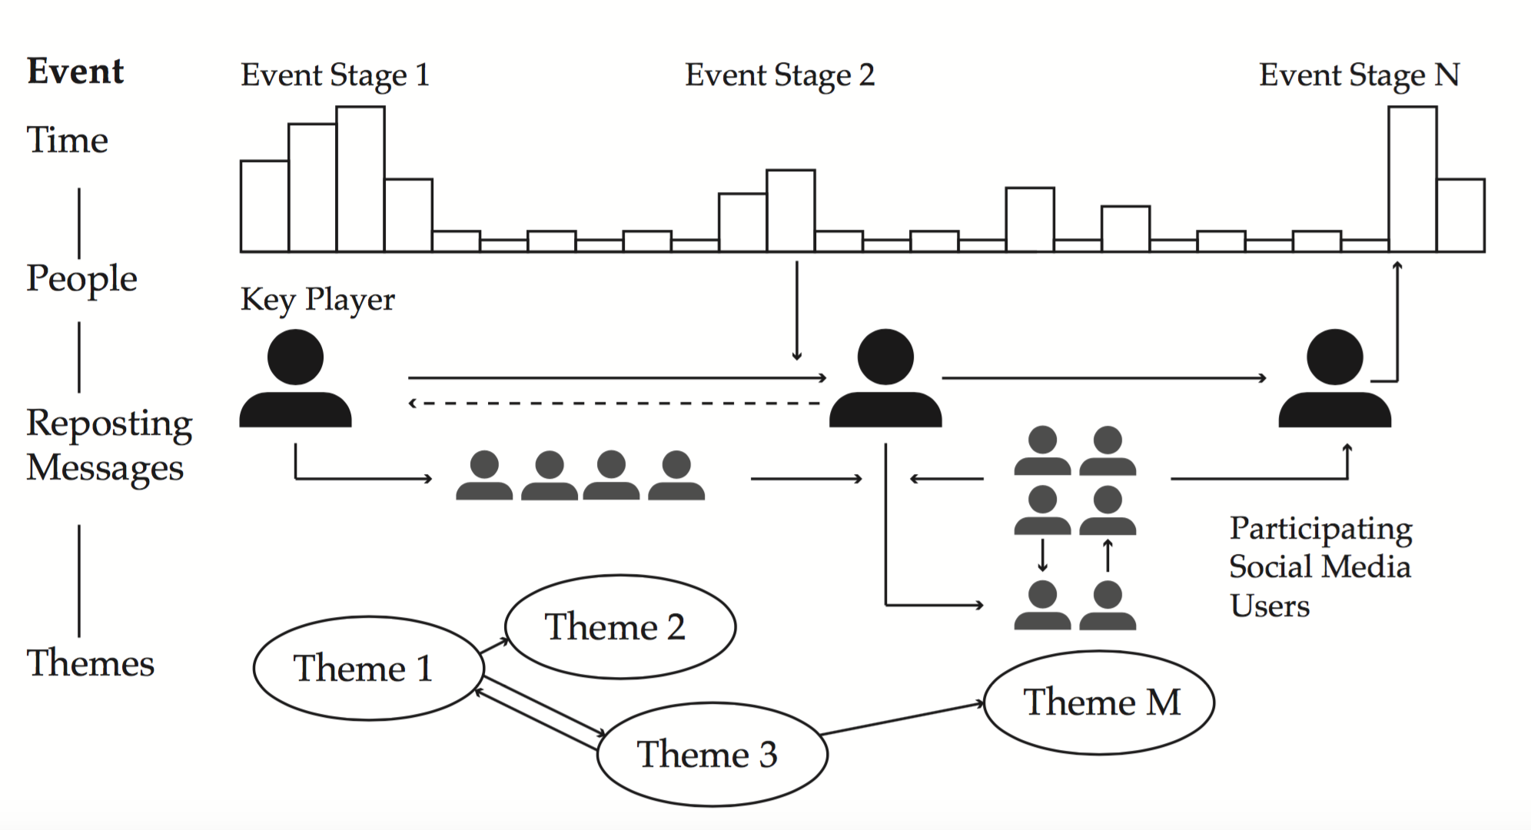
What is Event?
Event : real phenomenon represented as hashtag (# ) and keywords
An event consists of 4 features :
D1: Multiple event stages
D2: Influence of Key Players
D3: Posting and Reposting Behaviors
D4: Dynamic changes of different themes
Notes:
An event is social phenomenon associated with hashtag
can be characterized by 4 features : time, people, reposting msg, themes
D1 : event evolution, how event changes from first stage to last stage
D2 : users can influence other users to repost messages. Key players= the opinion leaders who influence other users
D3: new opinions added to the events with hashtag and keywords
D4: themes : themes/topics change in different stages

Slide 4
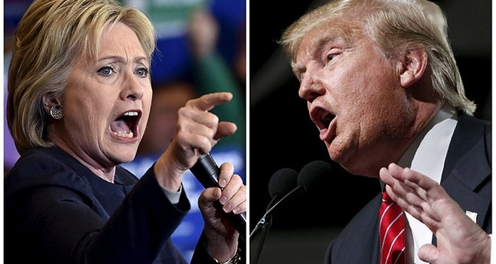
Problems in Social Media
Complex event evolution.
Dynamic user behaviors ? Tweet & Retweet
The relationship between event evolution and user behaviors ?
2016 US Election (Reuters photo)
Notes:
Complex development,thousands-millions people tweet in US election 2016,
Tweet and retweet in sensitive topics.

Slide 5
Purposes of E-Map
R1 : Providing a view for event summary with semantics and temporal trends.
R2 : Grouping messages based on their similarity in discussing themes and reposting relationships
R3: Detecting and presenting themes in different time periods.
R4: Identifying behavior patterns of social media users in posting and reposting messages.
Notes:
R1 : Purpose : guide the in-depth analysis of different event stages.
R2: . Purpose : to help users understand the themes, their popularity and reposting relationship.
R3: Purpose : Keywords in different time periods should be visualized to help users see the change of themes, and to infer the thematic evolution of an event at different stages.
R4: Purpose : identify key players’ behavior influences event evolution, their discussions, how and when they are involved should be provided .

Slide 6
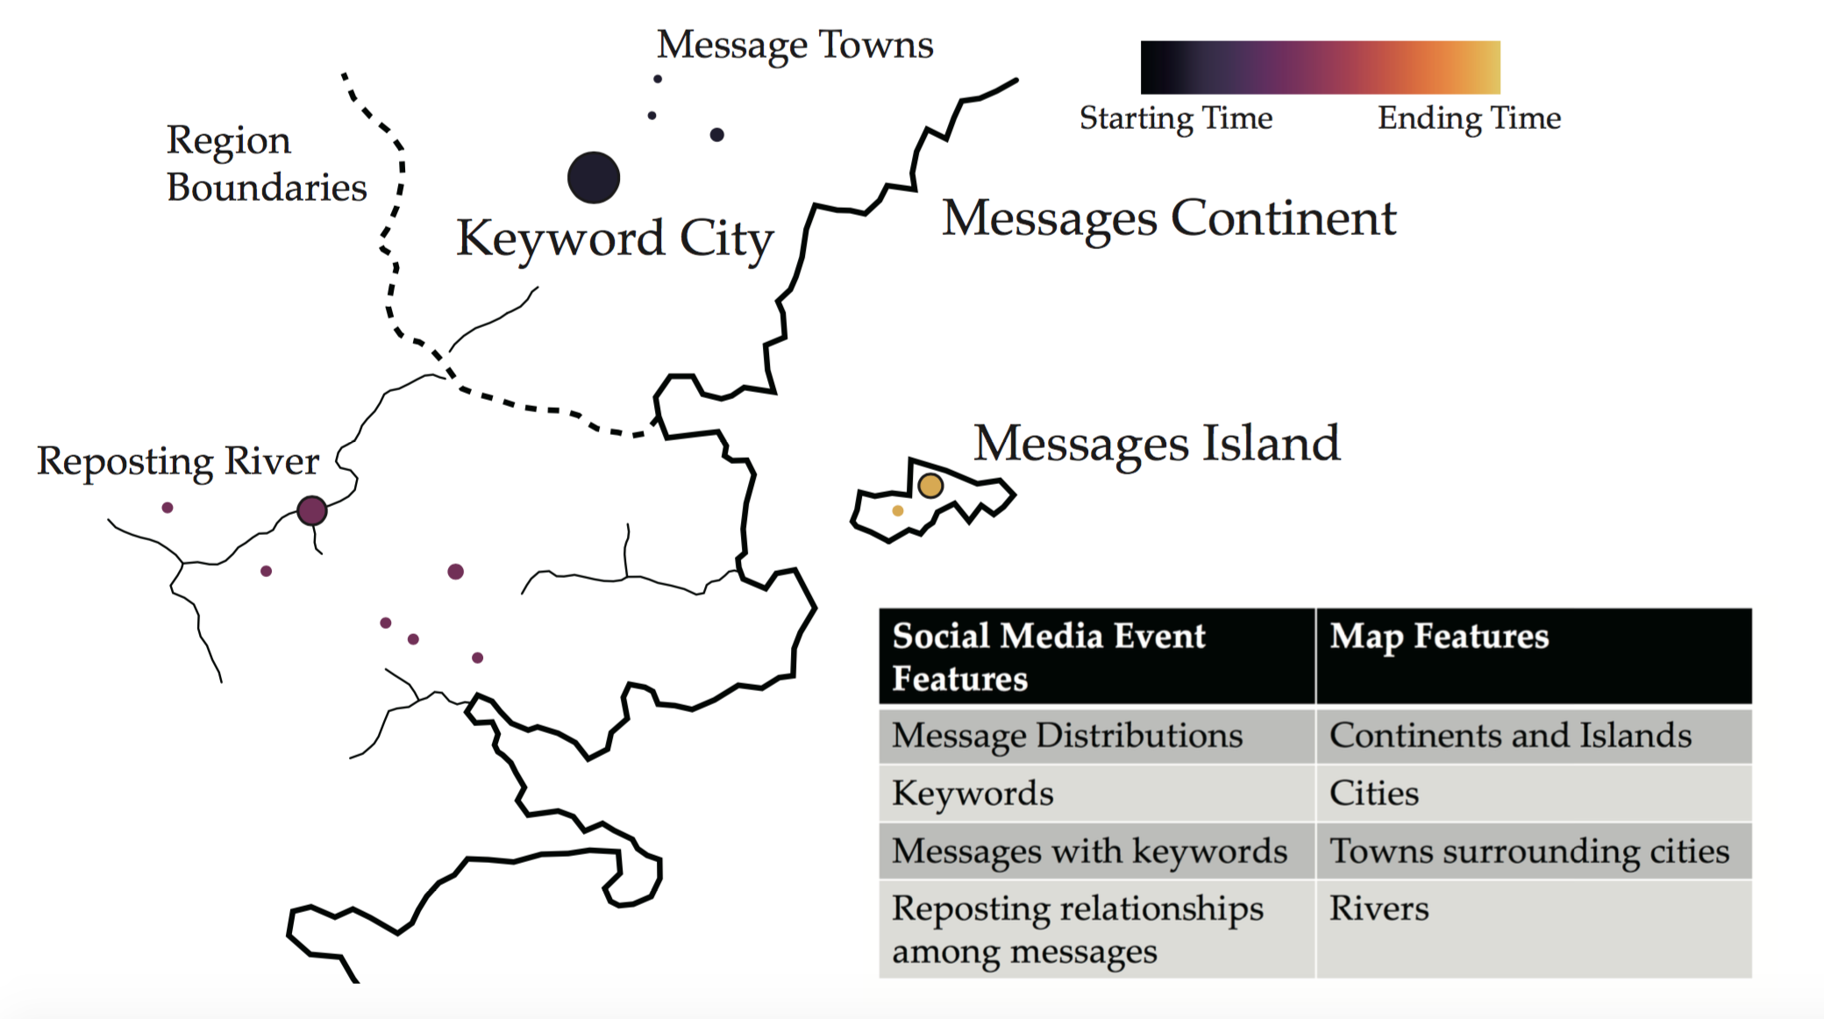
Methods
Platform : Sina Weibo
Keywords and Hashtag
Visual Encodings:
city, town, river, region, continent and island and color.
Notes:
Crawler to get Sina Weibo
Color to encode time

Slide 7
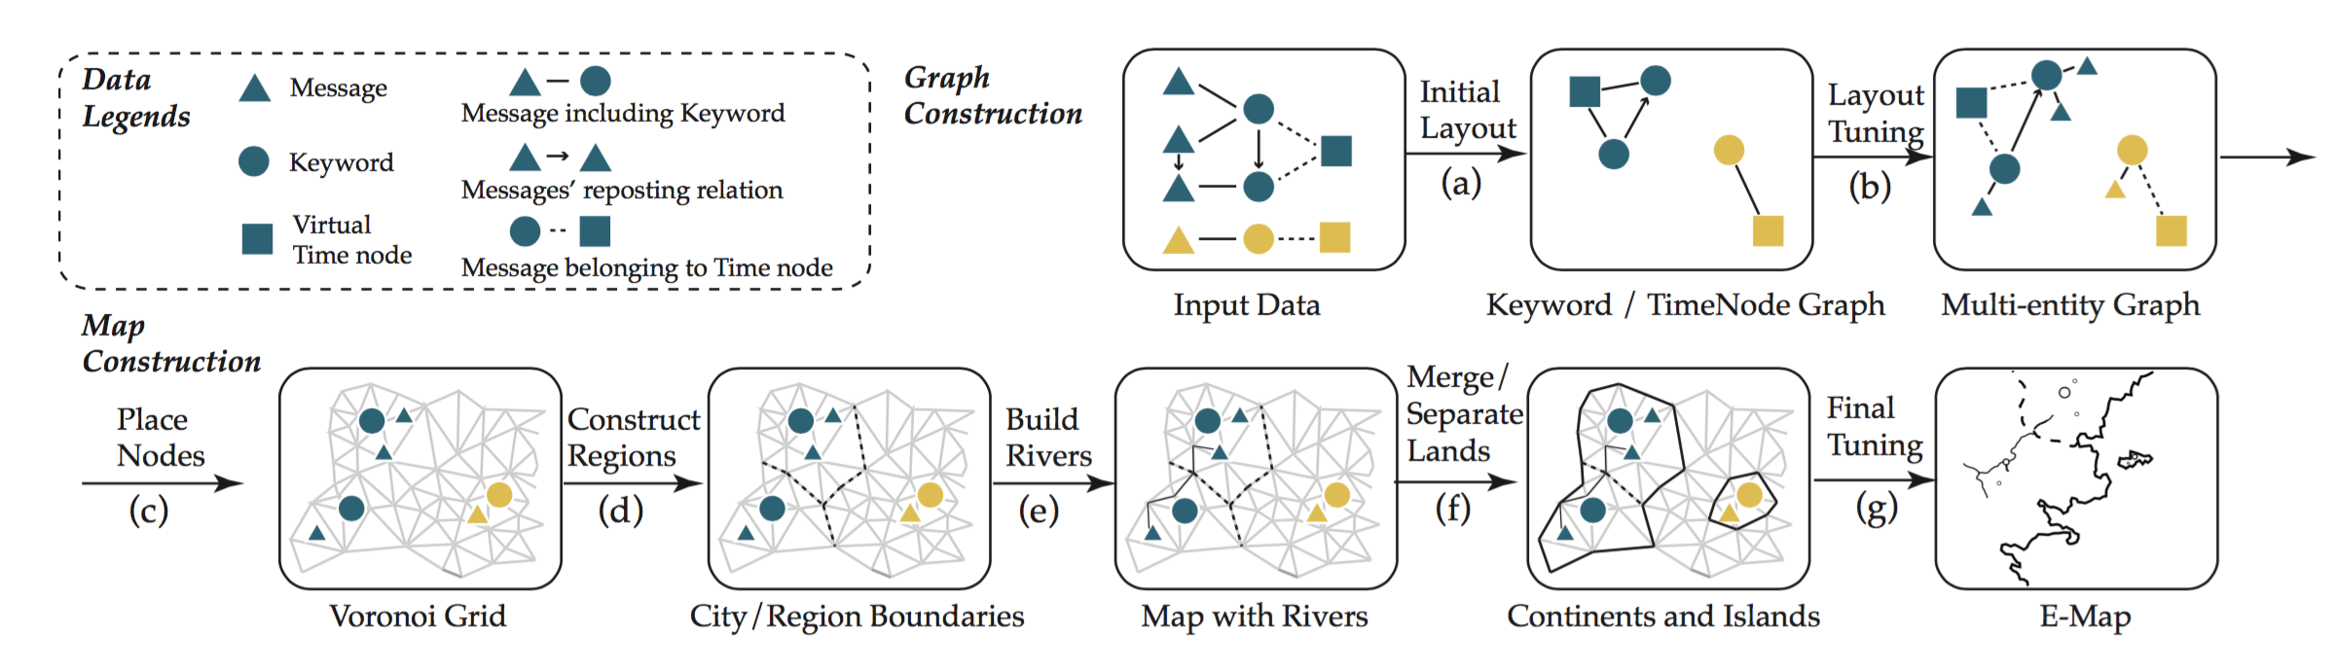
Methods
Graph Construction
Map Construction
Notes:
2 types of constructions :
Graph& map
Initial layout : keywords will be labelled in one particular time
Layout tuning: each messages contains particular keywords will be gathered close to the its keyword
Place nodes : place keywords and messaged in Voronoi grid
Regions : create the boundaries to separate the regions
Build rivers among regions

Slide 8
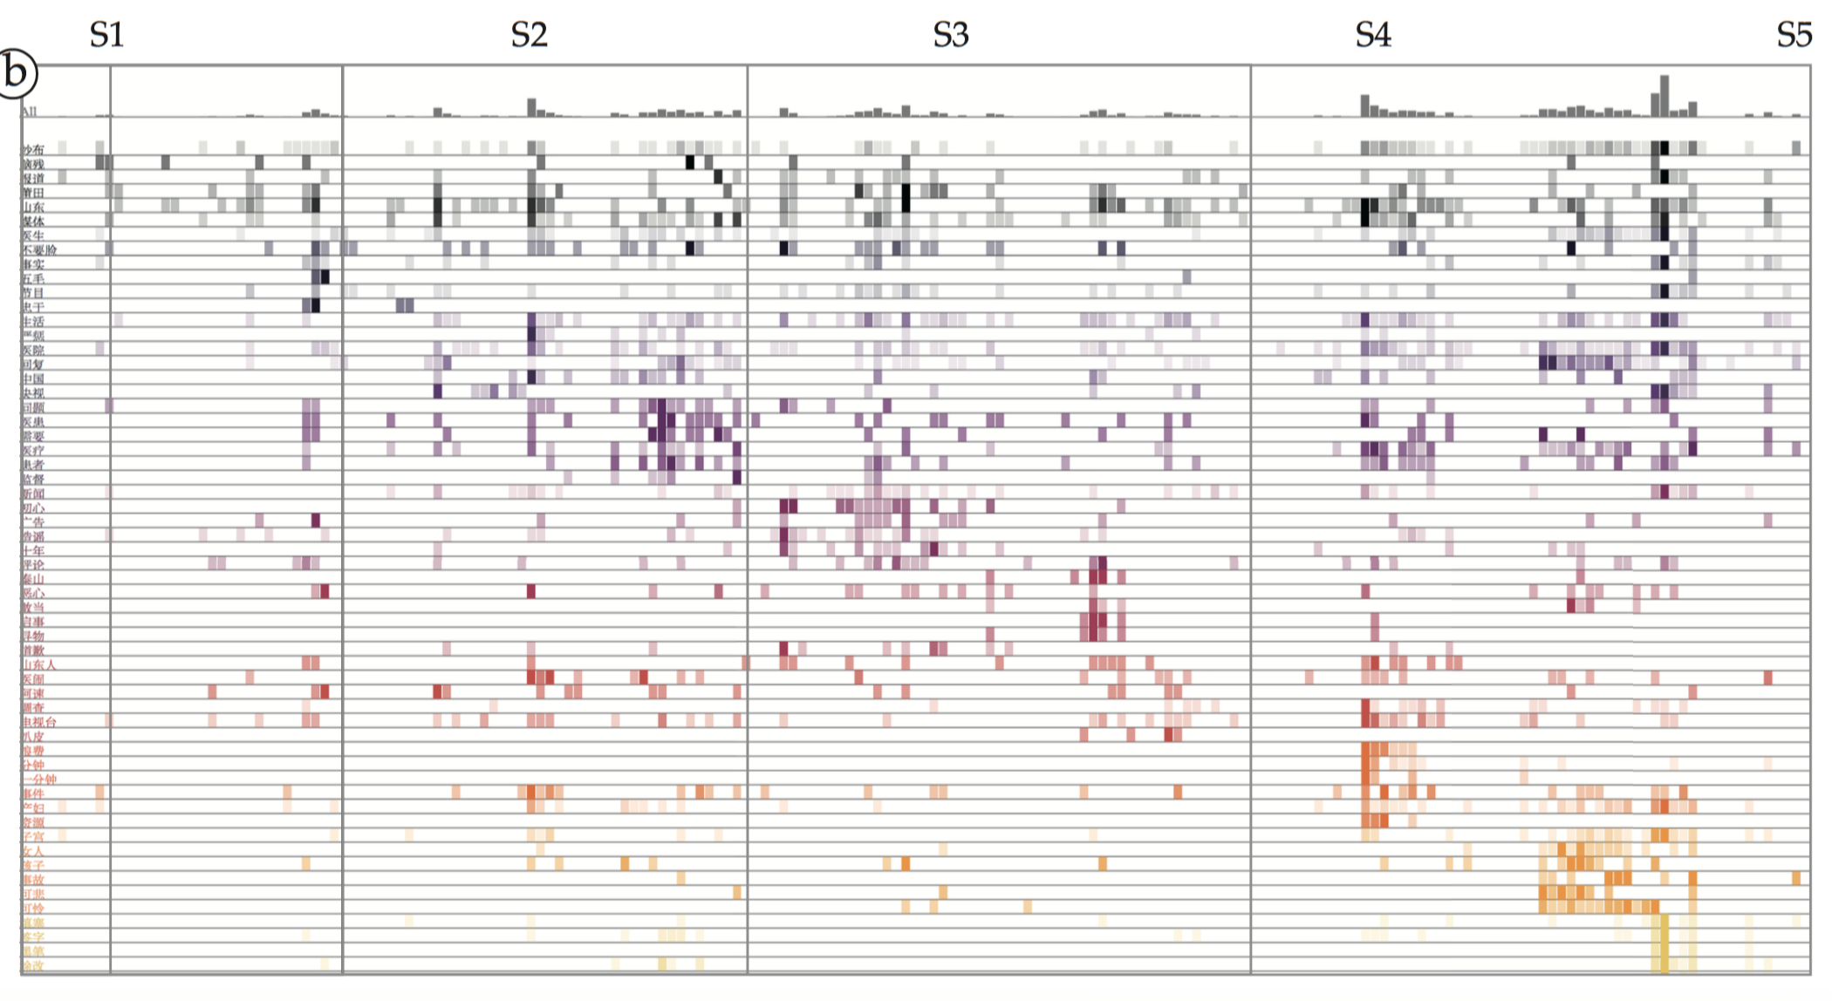
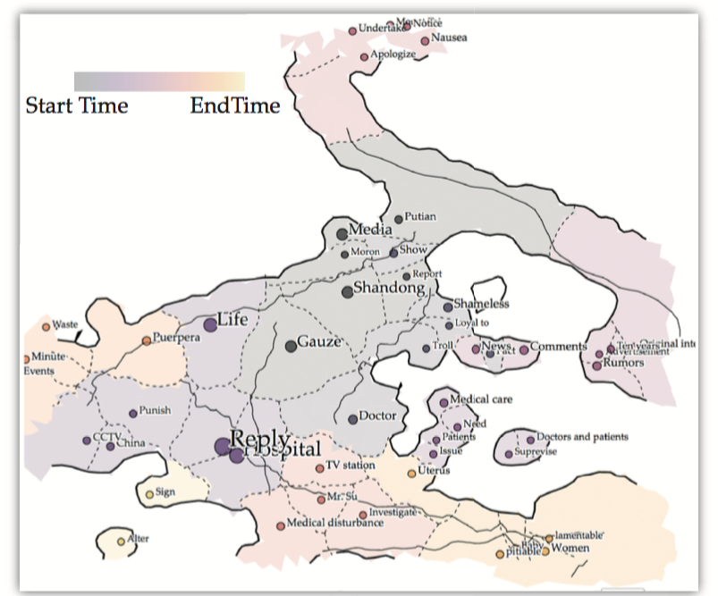
Results (R1) - Spatial & Temporal Overview
Spatial : distribution of important keywords through time
Temporal : intensity of keywords / keyword bursting
Notes:
Temporal view, u can see in which stage the keyword burst

Slide 9
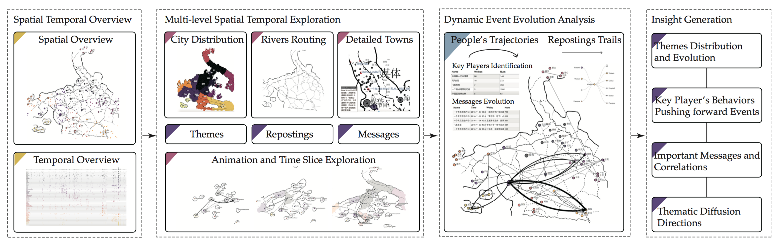
Results (R2) - Multi-level Spatial Temporal
Three types of interactions :
Animate the map construction
Imitation of Real-world map with zoom, navigation, clicking selection for in-depth analysis
User can select group of towns for analysis

Slide 10
Results (3) – Event Evolution Analytics
Trajectories reflect posting & reposting behaviours with different themes( in curve route)
Connections represent reposting using aggregation movement patterns(most influence connections are rivers)
Notes:
Two important features:
Trajectories of social media users and their connections/reposting behaviours
Thickness (number of messages).

Slide 11
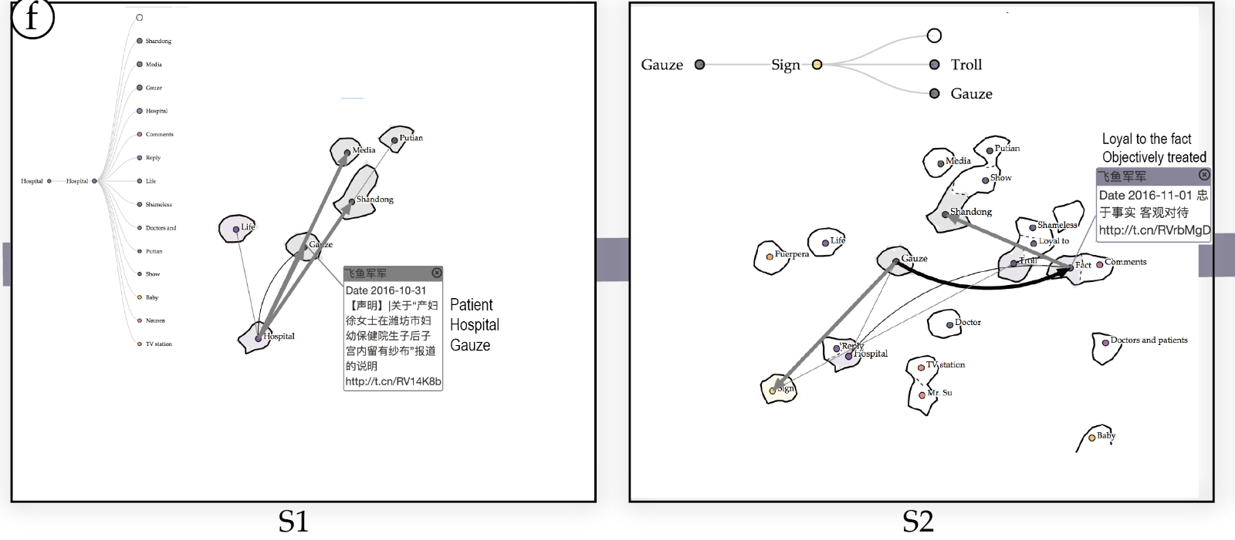
Example – Gauze Scandal
Gauze Scandal first seen in TV
Fact & Patient Reluctance of Signing to remove the gauze

Slide 12

Example – Gauze Scandal
CCTV (TV Channel) : Patient’s fault
Rumours & Putian Hospital

Slide 13

Example
Stable Map
Other keywords : Women, Pitiable, Uterus, Lamentable

Slide 14
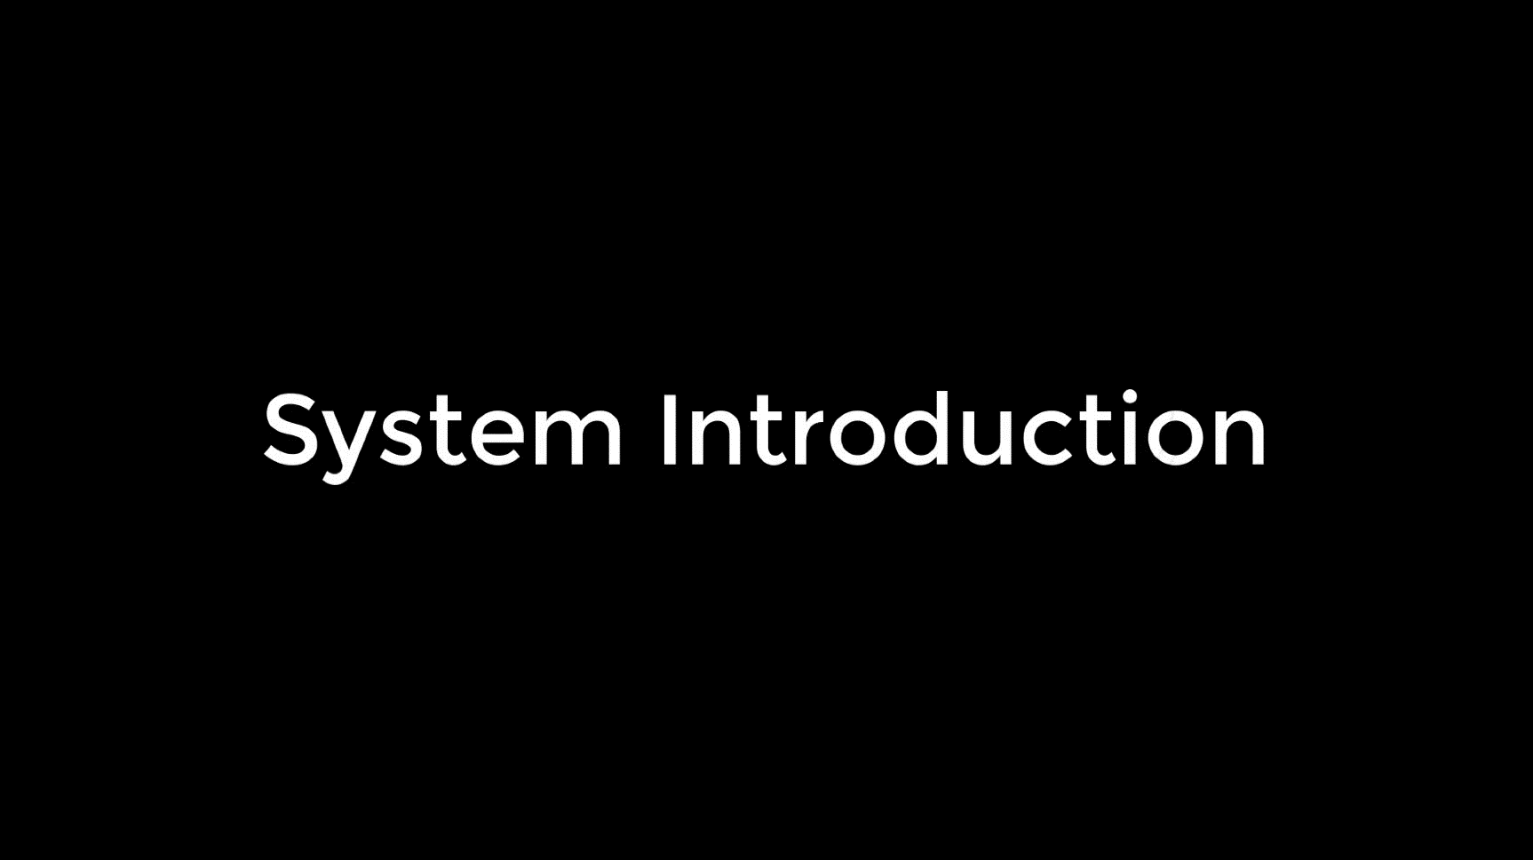
Example – Gauze Scandal

Slide 15
Conclusion
A novel event summary visualization based on social media data
(+) Natural map (Geographical map)
(+) Flexible interactions
A new visual analytics method for exploring user behaviours of social media users
(+) Dynamic time slicing and animation
(+) People trajectory and connection analysis

Slide 16
Take Away Messages
Landmarks : keywords as cities, messages as keywords, regions as area of keyword and towns, reposting connections as rivers, continent and islands as themes
E-Map can contain 10⁴ cities but it can only display 10³ cities due to perception scalability/visual clutter.
Direction and Layout Orientation have no meaning and only the distance has meaning.
Neighbouring cities may not be close in semantics(due to boundaries).
Notes:
Distance meaning is posting time

Slide 17
Question?

